Slide 1


Windows Azure BizTalk Services
Sandro Pereira
Senior Software Developer at DevScope
Microsoft Integration MVP
Lisboa
29 de Março

Slide 2


Sandro Pereira
Senior Software Developer at DevScope
Microsoft Integration MVP since 2011
Writer of numerous articles for Portuguese eMagazine “Programar”
Author “Sandro Pereira BizTalk Blog” http://sandroaspbiztalkblog.wordpress.com
Member of “BizTalkAdminsblogging.com” and “BizTalk Brasil” community
Member NetPonto community
MSDN BizTalk Forums Moderator
TechNet Wiki author (Wiki Ninja)
TechNet Gallery, Code Gallery and CodePlex contributor
Public speaker
Technical Reviewer PACKT Publishing
BizTalk Server 2010 Cookbook (April 2012)

Slide 3
Agenda
Introduction - Evolving Integration Needs
Windows Azure Service Bus overview
How can I get Started!
Migration Challenges
Demos
What’s next?

Slide 4
Evolving Integration Needs
The current stack integration From Microsoft

Slide 5



Current Microsoft integration stack
BizTalk Server
.NET/WCF/
AppFabric
Windows Azure Service Bus
Other

Slide 6




Evolving Integration Needs - New Challenges
Cloud services
Connected
Many applications
2010 Cloud
2000 SOA
1990 Web
1980 Client-Server
1970 Mainframe

Slide 7














Windows Azure
^{App} ^{services}
How do I build modern apps that connect services with devices
cloud services
caching
identity
service bus
media
mobile services
web sites
BizTalk Services
hpc
analytics
How do I manage data explosion?
^{Data} ^{services}
SQL database
HDInsight
Table
Blob storage
^{Infrastructure} ^{services}
How can my IT infrastructure keep up with my business?
Virtual machines
Virtual network
VPN
Traffic manager
CDN

Slide 8


Windows Azure
^{App} ^{services}
How do I integrate my enterprise and my business partners?
^{One} ^{Integration} ^{Stack}
How do I build modern apps that connect services with devices
cloud services
caching
identity
service bus
media
Mobile services
BizTalk services
API Mgmt.
mobile services
web sites
BizTalk Services
hpc
analytics
How do I manage data explosion?
^{Data} ^{services}
SQL database
HDInsight
Table
Blob storage
Service bus
Workflow
Active Directory
^{Infrastructure} ^{services}
How can my IT infrastructure keep up with my business?
Virtual machines
Virtual network
VPN
Traffic manager
CDN

Slide 9
Windows Azure BizTalk Services
…or Microsoft Azure BizTalk Services (from April 3, 2014)

Slide 10
Windows Azure BizTalk Services – GA
Mgmt./tools/infra.
On-demand, per tenant, dedicated deployment that provides isolation and predictable performance
Easy provisioning
Disaster recovery
Backup and restore
Programmatic access to management functions
Schema editor/test map in VS
Bridge configuration surface
Mapper Migration Tool Agreement Migration Tool
EAI
Transport adapters for FTP/FTPs, SFTP, HTTP
Hybrid connectivity to SQL, SAP, Oracle EBS, Oracle DB
Content based routing to Web services, SB queues, topics, relays
Transformation engine
Out-of-box integration pattern
Custom code in Bridge
B2B
EDI AS2 and X12
Trading Partner Management
Agreements config templates
EDI batching
Tracking
Archiving with NRR
TPM OM API

Slide 11
Windows Azure BizTalk Services – Feb 2014 Update
Support for EDIFACT Protocol
Improved Azure Service Bus integration
Simplified setup for on premise connectivity
Scheduled auto backup capability
Support for Operations logs

Slide 12
VETER
Transform
Connect LOB
EAI Capabilities
Enterprise Application Integration (EAI) which provide rich message processing capabilities and the ability to connect private cloud assets to the public cloud.

Slide 13

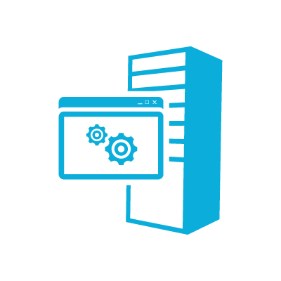



EAI – Incident Management Scenario
Web
Service
Bridge
User 1 via phone
customerType == “VIP”
EAI Bridge
(routing based on condition)
User 2 via online
LOB Relay
Behind Constoso’s Firewall
Partners
FTP Shares could be on-premise or in Cloud
customerType == “Default”
Service Bus Connect
Line of Business System
Validate – Enrich – Transform – Enrich - Route (VETER)
FTP Share 1
LOB Target
FTP Share 2

Slide 14


B2B comm
Portal
EDI Capabilities
Electronic Data Interchange (EDI) targeted at business-to-business (B2B) scenarios in the form of a finished service built for trading partner management.

Slide 15

EDI Service Order Processing Scenario
TPM Portal
EDI App
EDI
EDI Bridge
Service Bus
Hybrid Connectivity
TPM
AS2
BAM
Orders
EDIFACT
X12
FTP
10.000+ EDI schemas
Sales Dashboard
(ASP .NET)
Order Management LOB System
Northwind
Contoso

Slide 16
How can I GET STARTED?
Windows Azure BizTalk Services

Slide 17

Requirements
Platform
Windows 7 Service Pack 1, Windows 8, Windows 8.1, Windows Server 2008 R2 SP1, Windows Server 2012, Windows Server 2012 R2
Microsoft Visual Studio 2012 - Microsoft Visual C# .NET is the minimum requirement, , .NET Framework 3.5 or 4.5
Windows Azure BizTalk Services SDK, February update
You can download the Windows Azure BizTalk Services SDK– February update from http://www.microsoft.com/en-us/download/details.aspx?id=39087
BizTalk Services Documentation http://msdn.microsoft.com/en-us/library/windowsazure/hh689864.aspx
MicrosoftEdiXSDTemplates.zip
Tools.zip
WindowsAzureBizTalkServicesSetup-x64.exe
WindowsAzureBizTalkServicesSetup-x86.exe

Slide 18
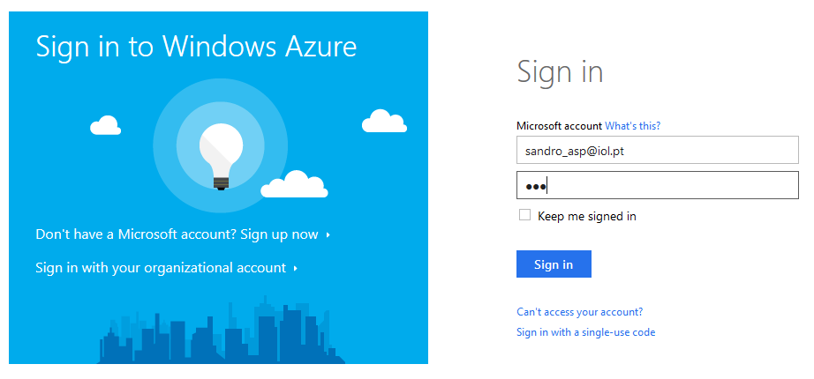
Provision a Windows Azure BizTalk Service

Slide 19
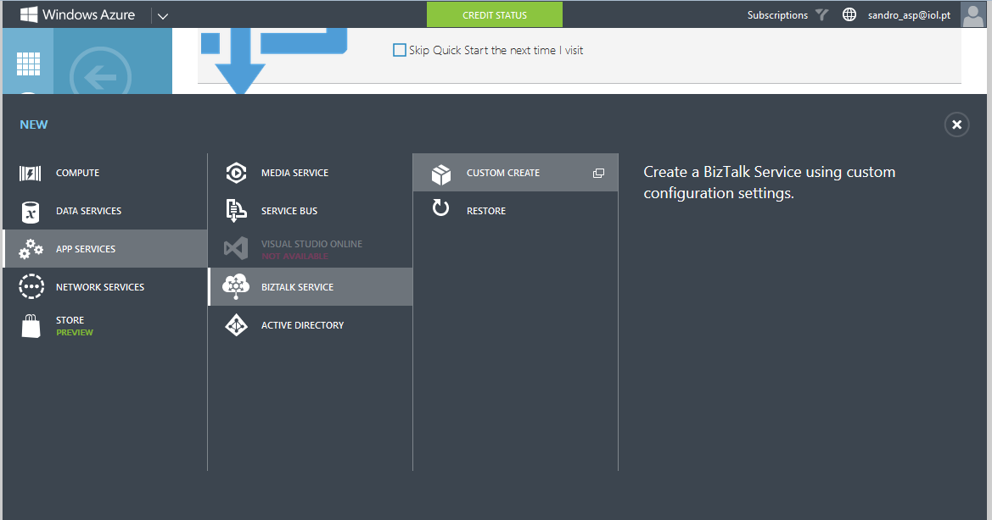
Provision a Windows Azure BizTalk Service

Slide 20
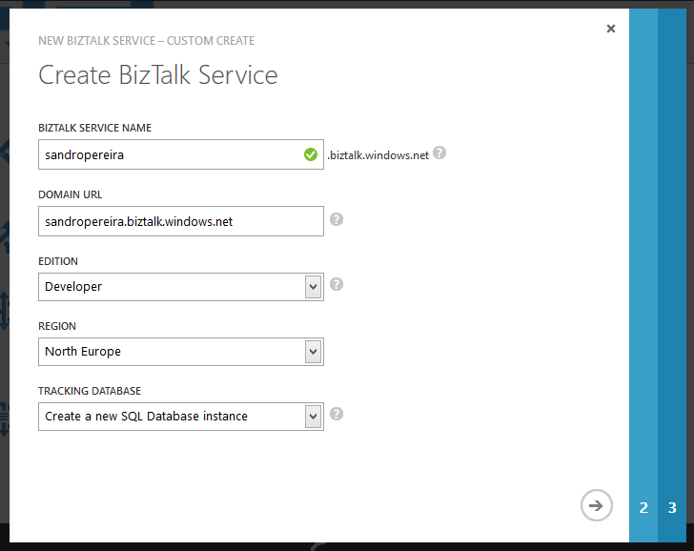
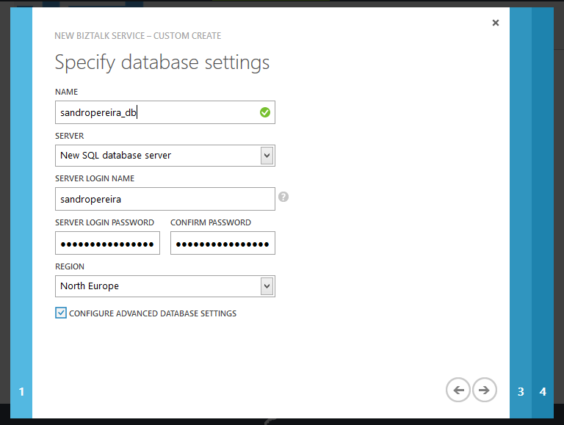
Provision a Windows Azure BizTalk Service

Slide 21
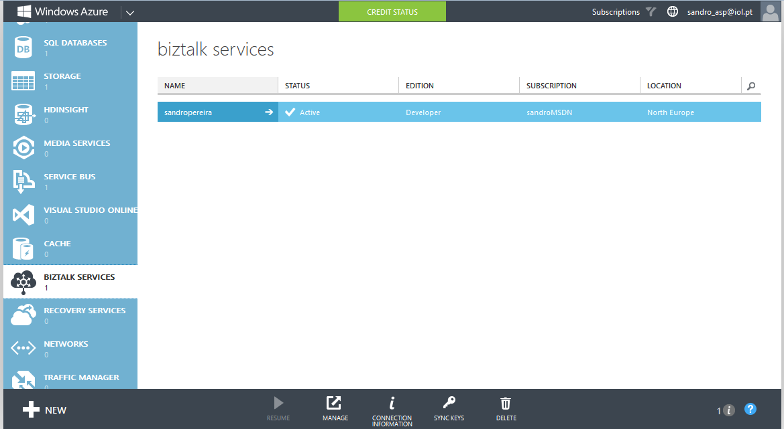
Provision a Windows Azure BizTalk Service

Slide 22
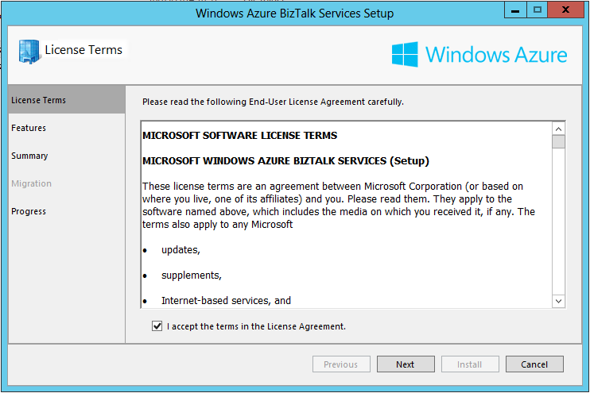
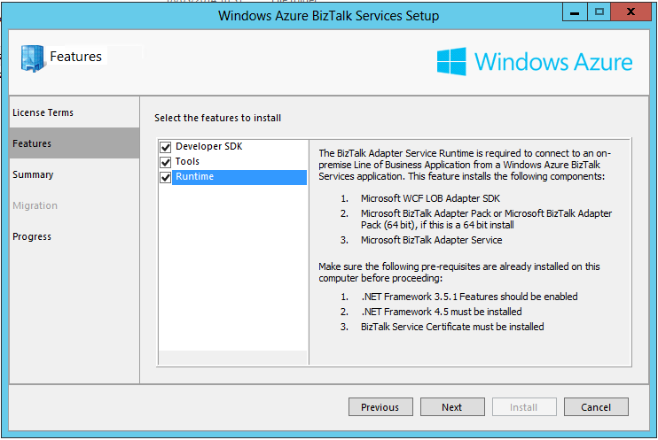
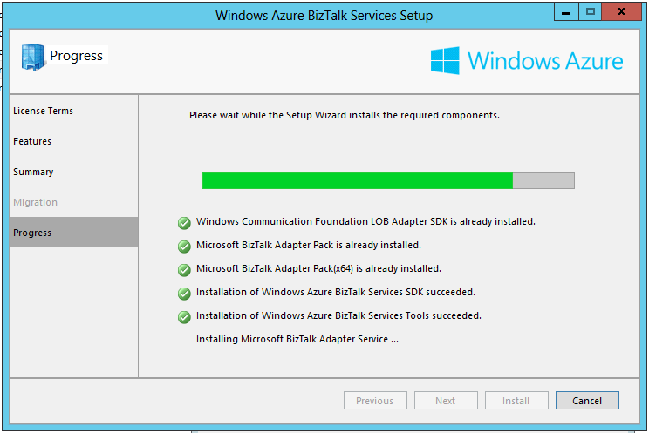
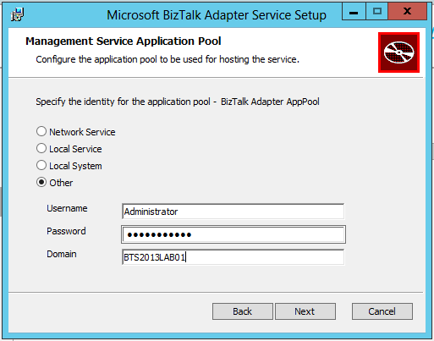
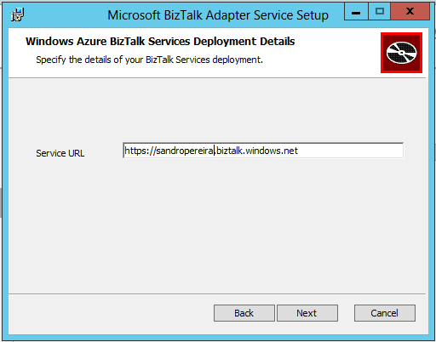
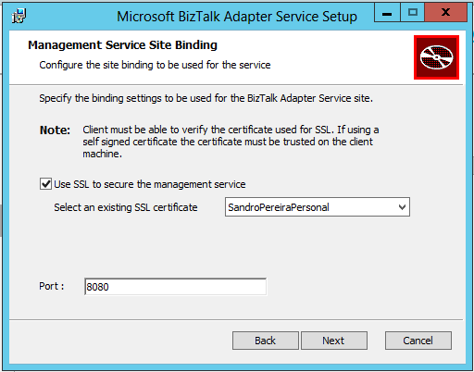
Installing Windows Azure BizTalk Services SDK

Slide 23
Migration Challenges
Main differences and challengers between BizTalk Server and WABS

Slide 24


The Challenge
XML EDI or Flat File
XML EDI or Flat File
BizTalk Server architecture
Ports
Pipelines
Maps
Orchestration
Rules
Adapters
EDI TPM
BAM, Tracking
Oh my!
Receive Port
Orchestration
Send Port
Receive Adapter
Receive Location
Send Adapter
Receive Pipeline
Send Pipeline
Mapping
Mapping
FROM: Contoso (Flat file format)
TO: NWTraders (Flat file format)
MessageBox
TO: Fabrikam (XML format)
FROM: Fabrikam (XML format)

Slide 25
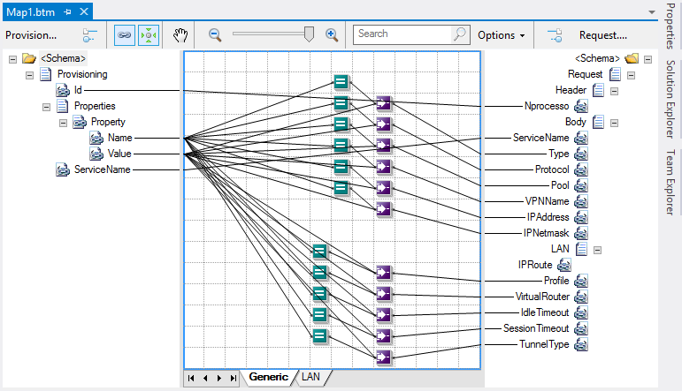
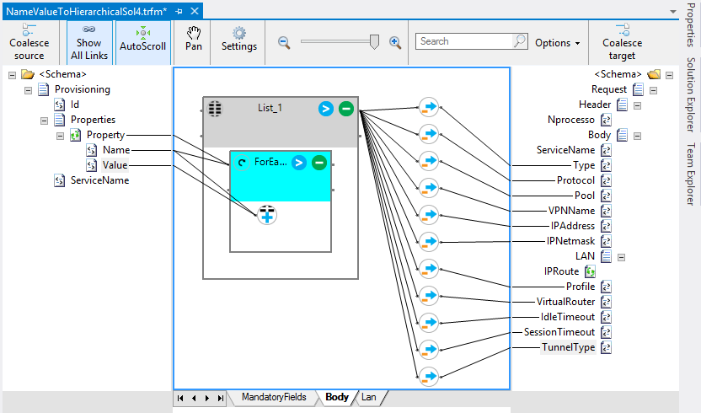
Maps
Mapping is fundamental to integration
But mapping has been rewritten in WABS
Still schema based and XML schema fully supported in WABS
Two approaches
Maps in BizTalk Server are ‘just’ XSLT most of the time – i.e. no code
Maps can be converted to transforms in WABS
WABS transforms can support XSLT (1.0)
WABS provides command line map conversion tool
BizTalk Mapper Design
Functoids (Advanced, Conversion, Cumulative, Database, Date and Time, Logical, Mathematical, Scientific, String)
The transformation are created using XSLT
Transform Designer
Operations (String Operations, Loop Operations, List Operations, Cumulative Operations, Date / Time Operations, Miscellaneous Operations, Expressions)
The transformation are created using Extensible Application Markup Language (XAML)

Slide 26
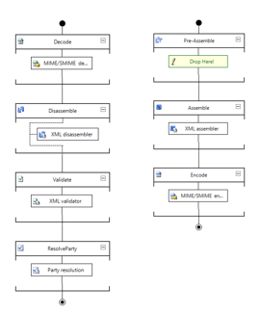
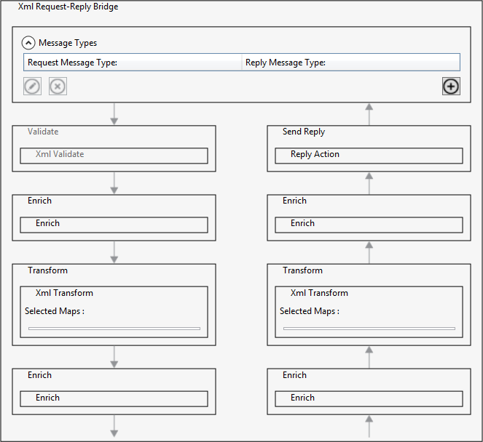
Pipelines
Bridges in WABS are a funky combination of pipeline and processing
Bridges are stateless
Bridges are not transactional (because they are stateless)
Bridges have predefined processing stages
Bridges allow custom code
Bridges can call other bridges
Bridge templates are not extensible
So bridges are pretty fundamental too
BizTalk Pipelines
Custom processing via pipeline components
WABS Bridges
Custom processing via message inspectors

Slide 27
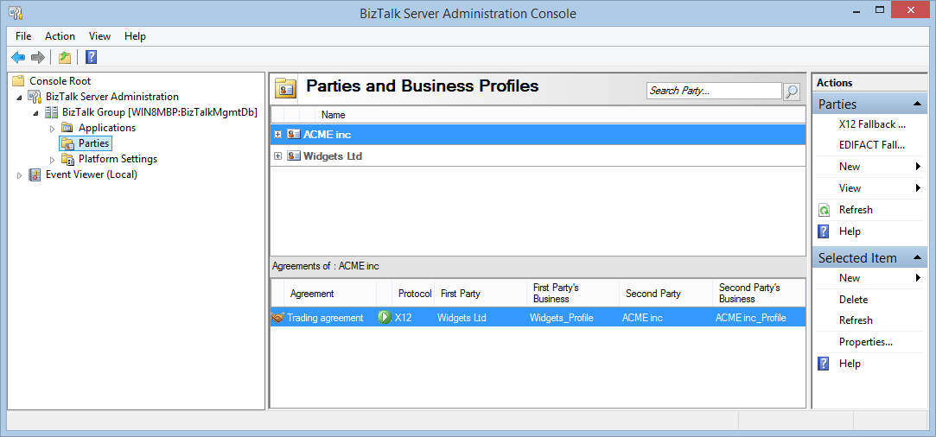
Trading Partner Management
WABS TPM is compatible with BizTalk Server
Tooling provided to move trading partners and agreements to WABS
WABS now supports EDIFACT as well as X12 and AS2

Slide 28
Now for the tough stuff
Orchestration migration
Hard problem to solve
But often used, often unnecessarily
Workflow is planned in service but not yet and not compatible
BAM / Tracking
WABS provides tracking infrastructure, SQL Azure database that is very useful for monitoring
Business activity monitoring is planned
BRE
Support is planned, aim is to be compatible with BizTalk rules
For now, workflow and workflow rules provides an alternative

Slide 29
What makes sense to move?
Not everything
May depends on data classification
Where data is coming from/going to
Not for On-prem <> on-prem EAI
But very useful for cloud <> cloud
It’s not all or nothing
Consider moving part of a solution to the cloud, keeping the rest on prem
Hybrid integration patterns are important

Slide 30
DEMO
EAI Capabilities (Transform, VETER, CBR, Connect LOB)
EDI Capabilities (B2B comm, Portal)

Slide 31
What’s next?
Still to come... In Windows Azure BizTalk Services

Slide 32
Windows Azure BizTalk Services – Next
Mgmt./tools
AAD integration
Better integrated one mgmt. experience
EAI
Adapter extensibility
Derived type support in transforms
JSON support
Pull from LOBs
B2B
Agreement decoupling
AS2 enhancements & certification
Custom code in EDI
BPM
Workflow
Rules engine
Process designer
Rules designer

Slide 33
Closure
BizTalk services will be updated on quarterly cadence
Introducing Business Process Management shortly
Extensibility is an opportunity for Partners

Slide 34


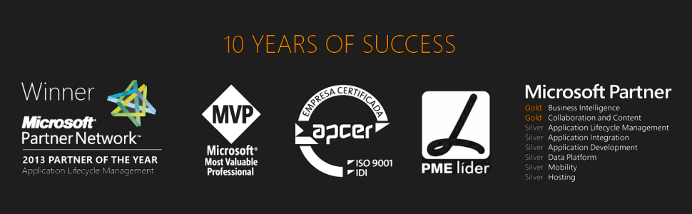


Questions?
sandro.pereira@devscope.net
linkedin.com/in/sandropereira
@sandro_asp
sandroaspbiztalkblog.wordpress.com
www.devscope.net

Slide 35
Thanks
+351 223 751 350
www.devscope.net

